Slide 1
CS454: Software Engineering-3 Mobile Software Engineering Mobile Applications Architecture & Design

Slide 2
Introduction
This unit describes concepts related to mobile apps architecture and presents design guidelines for key architecture components.
By the end of this unit, a student should be able to create architecture that meets “best practices”; minimizes costs and maintenance requirements; and promotes usability and extendibility.

Slide 3
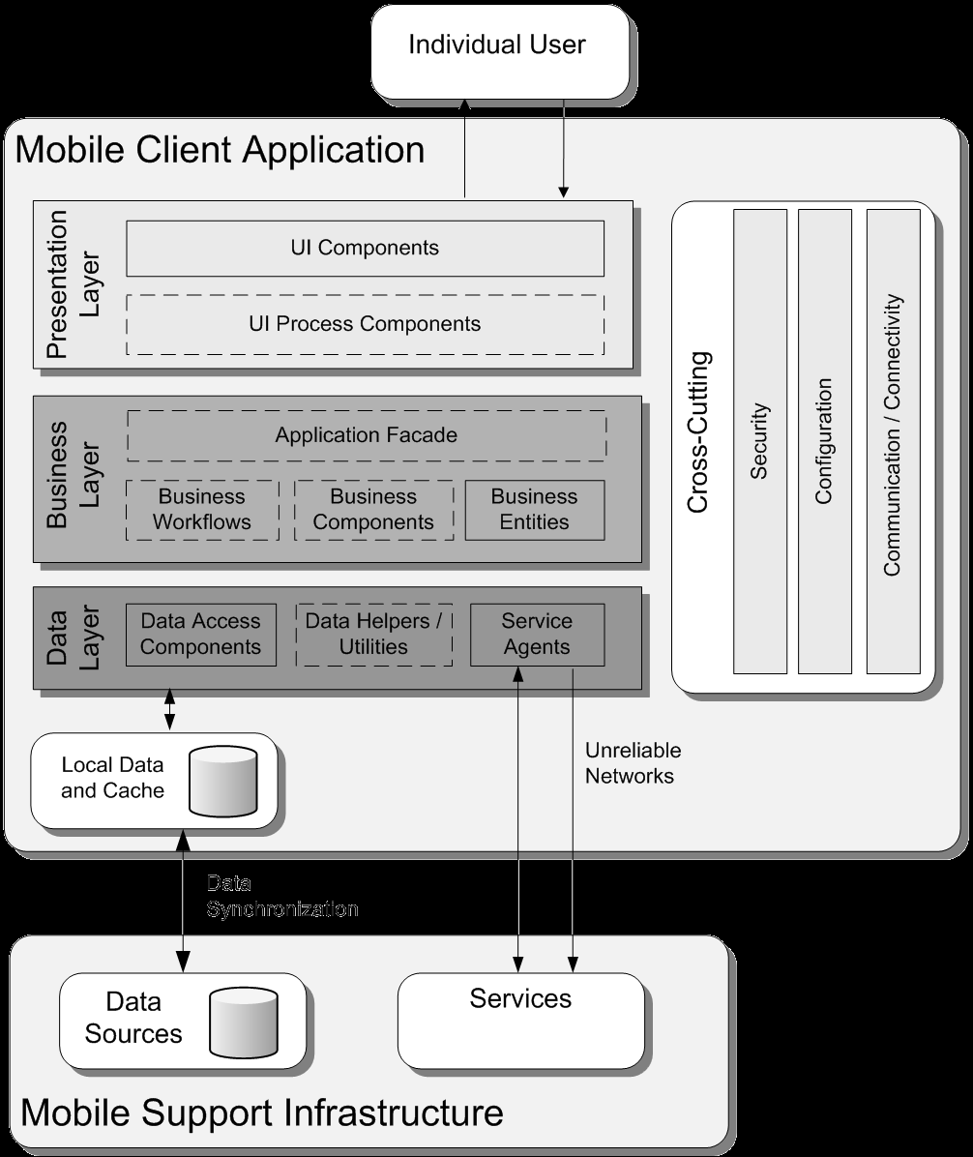
A typical mobile app architecture
Stacked Layers:
User interface
Business logic
Data access
Cross-cutting concerns:
Security
Communication
Logging
Caching

Slide 4
User interface layer
User Interface (UI) Components
Specify overall Layout and individual UI controls
Allow users to interact with the application
Render and format data for users
Acquire and validate data input by users
UI Process Components
Synchronize and orchestrate user interactions
Useful if UI is complicated
Separate user process components for common user interaction patterns allow reusability in multiple UIs

Slide 5
Business logic layer
Application Façade (optional)
Combines multiple business operations into a single message-based operation
The application façade can be accessed from the presentation layer using different communication technologies
Business Components
Provide business services, such as processing business rules and interacting with data access components
For example, a business component can implement a transaction script pattern, which executes multiple operations to manage a transaction

Slide 6
Business logic layer
Business Entities
used to pass data between business components
The data can represent real-world business entities, such as products and orders, or database entities, such as tables and views
scalar values can be considered as business entities
business entities can also be implemented using data structures such as DataSets and Extensible Markup Language (XML) documents

Slide 7
Business logic layer
Business Workflows
Multiple steps that must be performed in the correct order and orchestrated
Define and coordinate long-running, multi-step business processes
Workflow styles:
Sequential - enforces a certain sequence of actions
State-machine - remains in a given state and waits till an event occurs before transitioning to another state
Data-driven - the workflow is dependent on data values which is specifically for document approval workflows

Slide 8
Data access layer
Provides access to data stored in a server or cached at a client
Data is not necessarily relational.
It may be JSON or XML data accessible via web services
Creating the data access layer is largely automated using data access frameworks

Slide 9
Data access layer
Data access logic components
Abstract the logic necessary to access underlying data stores
Centralizes data access functionality, which makes the application easier to configure and maintain
Data helpers / utilities
Consist of specialized libraries and/or custom routines especially designed to maximize data access performance and reduce the development requirements of the data access logic components and service agent parts of the layer

Slide 10
Data access layer
Service agents
Manages the semantics of communicating with an external service which is accessed when a business component uses functionality exposed by this service
Isolate user application from the details of calling diverse services
Provide additional services such as basic mapping between the data format exposed by the external service and the data format required by the application

Slide 11
Mobile app key architectural design principles
Separation of concerns: an app should be broken into disjoint components as overlapping functionalities should be avoided
Single responsibility: a component should be responsible for only one specific functionality
Principle of least knowledge: a component should not know about internal details of other components
Don’t repeat yourself: the functionality should not be duplicated in any more than one component

Slide 12
Mobile app key architectural design principles
Avoid doing a big design upfront: especially, if the requirements are incomplete, unclear or still evolving.
Favor composition over inheritance: to avoid dependency among components; inheritance increases dependency between parent and child classes, thereby limiting the reuse of child classes
Keep cross-cutting code abstracted from the application business logic as much as possible: mixing code with business logic can lead to a design that is difficult to extend and maintain

Slide 13
Mobile user interface guidelines
Support multiple mobile-specific input mechanisms such as touch screens, stylus pens and voice recognition
Take into consideration variability in screen specifications such as screen size, resolution, supported color depth and other screen-specific parameters.
The user interface should support both landscape and portrait orientations.

Slide 14
Mobile user interface guidelines
The app should be able to retain and restore a navigation state for two reasons:
switching between apps occurs unpredictably due to events such as receiving a call or a text message
mobile apps usage sessions tend to be short (2 to 9 minutes) leading to frequent opening and closing of a given app.
User experience (UX) must be completely addressed
the richness and ease of use of the user interface is a prime deciding factor for many users
a great deal of effort should be spent on interviews, surveys and usability studies to determine common user expectations

Slide 15
Cross-cutting concerns
Security
Communication
Configuration
Caching
Logging
Power management
Performance
Porting
Exception handling

Slide 16
Caching considerations
Cache static data, and not volatile data.
Caching sensitive data should be avoided.
The fastest storage option should be used for caching.
Cache access should be thread-safe.
Cached data should be refreshed frequently.

Slide 17
Logging considerations
Do not store sensitive information in log files
Consider logging in compressed formats to minimize memory and storage impact when extensive logging is carried out on the device
Use platform features such as health monitoring on the server, and mobile device services on the device, to log events
Whenever network connectivity is available , synchronize between the mobile database logs and the server database logs to maintain audit capabilities on the server
Decide what constitutes unusual or suspicious activity on a device, and log information based on these scenarios

Slide 18
Power management considerations
UI is not updated while the application is in the background
Communication methods that use the least amount of power are used
Power profiles are implemented to increase performance when device is plugged into external power
Power consumption is considered when using the device CPU, wireless communication, screen, or other power-consuming resources while on battery power
Device functionality is allowed to be powered down when not in use or not needed

Slide 19
Performance considerations
Support configurable options to allow the maximum use of device capabilities
Consider using lazy resource acquisition to optimize for mobile device resource constraints
Optimize the application to use the minimum amount of memory. The app may release uneeded memory when memory is low
Balance performance requirements with power consumption requirements

Slide 20
Deployment Concerns & Patterns
When choosing a deployment pattern:
Understand the target physical environment for deployment
Understand the architectural and design constraints based on the deployment environment
Understand the security, performance, quality of service impacts of your deployment environment

Slide 21
Deployment Concerns & Patterns
Server vs. Client
Server:
Requires reliable network connection
Business and data layers are placed on the server
Mobile device power consumption is not optimized due to permanent connectivity to server

Slide 22
Deployment Concerns & Patterns
Client:
Mobile app permits local processing and allows an occasionally-connected state
Business and data layers are embedded in the mobile app
Complicated app development specially for different mobile application platforms that must be targeted
Caching should be used to gracefully handle disconnections
Hard to maintain as modifications of business or data layers must be propagated to all users
Keeping business data on a mobile device entails a security risk

Slide 23
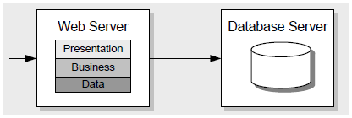
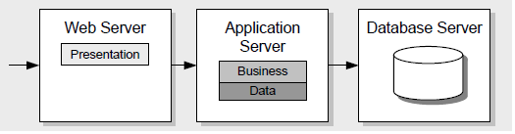
Distributed vs Non-distributed Deployment

Slide 24
Scale Up vs Scale Out after deployment
When scaling your application, choose from and combine two basic choices:
Scale Up: Get a bigger box
add hardware such as processors, RAM, and network interface cards (NICs) to existing servers to support increased capacity
Scale Out: Get more boxes
add more servers and use load-balancing and clustering solutions
protects against hardware failures via replication

Slide 25
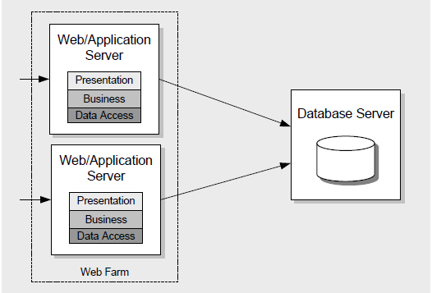
Web Farm

Slide 26
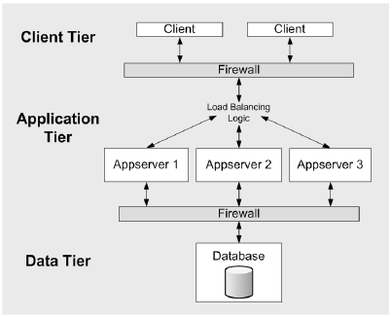
Load Balanced Cluster

Slide 27
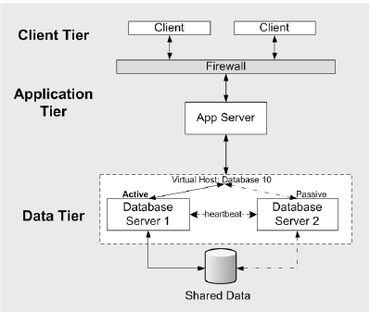
Fail Over Cluster

Slide 28
References
Chapters 1, 2 and 8 - J.D. Meier, Alex Homer, David Hill, Jason Taylor, Prashant Bansode, Lonnie Wall, Rob Boucher Jr and Akshay Bogawat , “Mobile Application Architecture Guide,” Application Architecture Pocket Guide Series, Microsoft Corporation 2008.

Slide 29
Thank you for
your attention.

